Slide 1
Customer Presentation
https://caweb.cdt.ca.gov/

Slide 2
CAWeb Publishing Service
Integrated Web Content Management System
Build on WordPress the #1 WCMS
All web technologies are provided as a Managed Service
System performance monitoring
Security built in with automatic updates
All supported State templates fully integrated
Website configuration provided
Automated Backups
20+ extended Features Via Plugins

Slide 3
The Webmaster Quandary
Focus on IT or business value?
Accessibility – certification required 7/2019
PDFs
Site content
More visually esthetic pages:
Powerful layouts and attention-grabbing dynamics
Better images of proper size
Your site metrics (Google Analytics) & SEO:
Performance of content presentation
Effectiveness of the information architecture

Slide 4
CAWeb Publishing Framework
WordPress CMS platform
Divi Theme from Elegant Themes
Responsive design
Drag and drop content modules
Custom layouts (and build your own)
State Template Child Theme
State Template v5.5 & v6.1.2
12 Full width modules
47 Standard width modules
All future versions

Slide 5
WordPress History
2003 WordPress born out of a desire for an elegant, well-architected personal publishing (blogs)
Open-source software licensed under GPLv2
Focused on:
Ease of use
Web standards
Very extensible modular design
High level of functionality

Slide 6
WordPress Today
31% of all websites
60% market share of all CMS sites
Next closest is Joomla with 6% ms
Reference

Slide 7
WordPress Architecture
Technical:
LAMP (Linux, Apache/Nginx, MySQL/MariaSQL & PHP)
Modular Framework:
WordPress core
Themes (look & feel, design)
Plugins (extensibility)
APIs

Slide 8
WordPress Core Functionality
Dashboard
Posts/News List/Feed (also covers content types)
Pages
Media Library (and gallery displays)
Comments – social (can be turned off)
Appearance – manage & configure:
Themes, Widgets, Menus
Plugins (more on next slide…)
Users – manage accounts and roles
Tools – export
Settings – numerous site configuration options
Mutisite – supports many sites within a single instance!

Slide 9
WordPress Plugin Extensions
50,000+ addressing an extensive list of functional enhancements
https://wordpress.org/plugins/
Some of the functionalities addressed:
World-wide security monitoring network
Web application firewall
Caching to increase response speed
Analytics (Google and others)
Social Integration and forums
Event Registrations and e-commerce
Google Maps integrations
Data visualizations
Live chat, forms and polls
Customized workflows
Tools: site migration/import, integrated customized help
Much, much more…

Slide 10
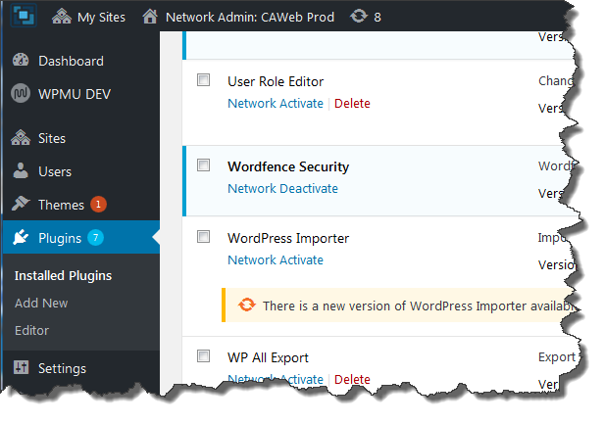
WordPress Software Distribution
Software is updated directly from the wordpress.org site
Security releases are updated automatically as soon as they are released!

Slide 11
WordPress Security
Your site is automatically updated with security releases
The WordPress Security Team is made up of approximately 25 experts including lead developers and security researchers.
In addition, there are numerous plugin developers that address WordPress security, including WordFence
Millions of Websites connected and monitored in real-time
A forensic lab continuously analyzing the latest threats
Web application firewall & threat defense feed
Blocking brute force attacks
Malware scanner & Auditing of Existing Passwords
An additional separate team of security professionals
Specific alerts & warnings, and technical WordPress security articles https://www.wordfence.com/
For more info on security: https://wordpress.org/about/security/

Slide 12
CAWeb Publishing Service Framework
WordPress 6.2.2 (as of 8/6/2023)
Theme: Divi by Elegant Themes
Divi is a premium theme and plugin
State Templates v5.5 & v6.1.2
Child theme methodology – one theme, many templates
Divi Builder Plugin: provides powerful and easy to use site editing.
Divi + CAWeb child theme = WordPress State Template
Multisite Plugins (the features and functionality provided are endless)

Slide 13
CAWeb Publishing Customers

Slide 14
CAWeb Publishing Features
Jim
Admin Functions
Navigation Menu
Site Settings
User Account creation
Media Library
Posts
Pages
Features (via Plugins)
Comprehensive table functionality (TablePress)
Feature-rich web forms (WPForms)
Simple workflow (Live Drafts & Public Preview)
And many more…

Slide 15
CAWeb Publishing Future
Two-Factor Authentication
Extended Workflow approval (beyond existing simple workflow)
Extended document management features
Events/Calendar & Event Registration
Backend Embedded Google Analytics Dashboard
Site storage usage widget.

