Slide 1
WordPress Framework
Managing the Software Environment for CAWeb

Slide 2
WordPress is a Huge Developer Community
126 Official WordCamps in 2017; 511,000+ active members in WordPress meetup groups all over the world
Over 30% of Web runs on WordPress, and 60% of CMS based sites run on WordPress
Powers 14.7% of the top 100 websites in the world
WordPress.com (hosting provider) draws more traffic than Amazon and is 4th in traffic in the US behind: Google, Facebook & Yahoo.
Many developers with over 50,000+ extensions and over 1 billion downloads on WordPress.org alone (and many more by other companies and individuals).

Slide 3
WP Framework
A very modular-functionality software architecture to help avoid execution conflicts
Core software, themes (and child themes) & plugins
WP API’s for:
Plugin, Shortcode, Dashboard Widgets, Settings, Widgets, Quicktags, Rewrite, Theme Customization
REST API
Specific to the database: Options, Transients, Metadata
Filesystem and more...

Slide 4
Software Testing & Debugging at a World-wide Scale
WP Core software and some popular themes & plugins have an installed base of millions of sites. Many others have thousands of installations.
If you choose quality themes and plugins, rarely is it necessary to rollback software from the WP Community (we never have had to yet).
Our own developed CAWeb theme and plugin is only tested by us (a couple people), consequently this is where most of our bugs come from.

Slide 5
Granular Software Update & Roll-back
Typical release could include:
Divi Theme
CAWeb (child) Theme
10 plugins
Totally separate rollback scenarios:
CAWeb (child) Theme and possibly with the Divi Theme
Single plugin causing a problem
Important: Never is it necessary to rollback everything. Nor do you want to!

Slide 6
Distributed Software Responsibility
WordPress.org - core software (automatic updates for minor/security releases)
WordPress.org - a number of our plugins
WordFence - security (automatic updates)
Elegant Themes - Divi core theme
WPMUDev - a number of plugins designed specifically for WP MultiSite
ServMask.com - special WP migration plugin
WPForms - special form for building forms
OntheGoSystems - WP toolset for applications without coding
GitHub - CAWeb developed theme and plugins

Slide 7
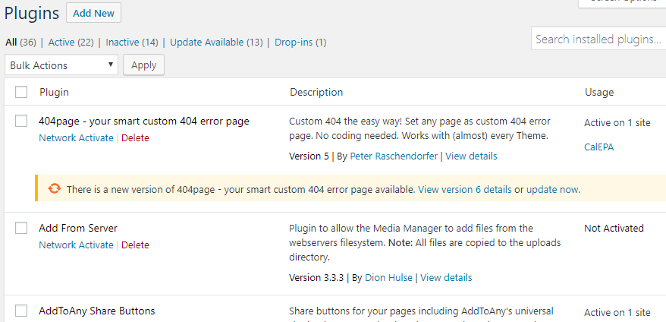
“Single-Click” Software Updates
Pulls from the 9 different repositories

Slide 8
WordPress Multisite
One WP Multisite instance where all the themes and plugins are installed
One database instance for the whole WP Multisite instance
Many websites (potentially 1,000s) running in this one WP Multisite instance
Each Website:
Can use a different combination of the plugins
Can have a customized individual configuration of a plugin

Slide 9
CAWeb use of VSTS
In the cloud VSTS - primarily for CAWeb child theme and the CAWeb plugin
User Stories
Bugs
Testing
Iterations Management
Release Planning

Slide 10
GitHub
Only for CAWeb child theme & CAWeb plugin
Code Repository
Build and Release
Note: we are being instructed to open this to the public for other State agencies to be free to use. So it is starting to make sense to also move everything from VSTS to GitHub so the State agencies can contribute feedback.

